Slide 1
Defect Tracking

Slide 2

What you will learn in next 30 minitues?
Definitions
How to report bug effectively
Lifecycle of a bug
Components of a Bug
Severity Vs Priority
Bug Tracking System

Slide 3
Definitions
Bug – an error, flaw, mistake, failure or fault in a computer program that prevents it from behaving as intended.[Producing an incorrect result]
Bug Tracking System (BTS)- a software application that is designed to help quality assurance and programmers keep track of reported software bugs in their work.
Bug Tracking- the process of reporting and tracking the progress of bugs from discovery through to resolution.
Bug Report -a report that details the bug found in a program.

Slide 4
How to report bug effectively
A bug cannot just simply stop at “it does not work”. That is not good enough.
Main principles needed to be taken into account in order to report a bug are:
Be clear n precise with description, so that others can reproduce.
b) No bug is too small.

Slide 5
Components of a Bug
Summary – Short description which describes the defect in general.
Steps to reproduce - Minimal set of steps that can be followed to reproduce the problem.
Actual result- This should describe as what actually happened supporting it with any error messages, screenshots
Expected result - This should describe the expected results which will explain why this error was reported.
Environment- This specifies as on which env. the problem occurred.

Slide 6
Severity Vs Priority
What is Severity?
Severity of a defect is related to how severe a bug is. Usually the severity is defined in terms of financial loss,
damage to environment and company's reputation.
Defect severity can be categorized into four class
Critical: application is not working/ major functionality is completely brown. tester can not do further testing.
tester is blocked.
Major: some part of functionality is brown, tester cannot test some part of functionality and there is no workaround.
Medium: In this type, defects are logical defects which does not block any functionality. It usually contains functional and major UI defects.
Low: It mostly contains UI defects, minor usability defects. defects which does not harm to application under test

Slide 7
What is Priority?
Priority of a defect is related to how quickly a bug should be fixed and deployed to live servers.
Defect priority can be categorized into three class
1) High : it has high business value, end user can not work, unless the defect gets fixed. in this case Priority should be High, means immediate fix of the defect.
2) Medium: end user can work using workaround but some functionality end user cannot use and that functionality is not regularly used by the user.
3) Low: no or very less impact on end user

Slide 8
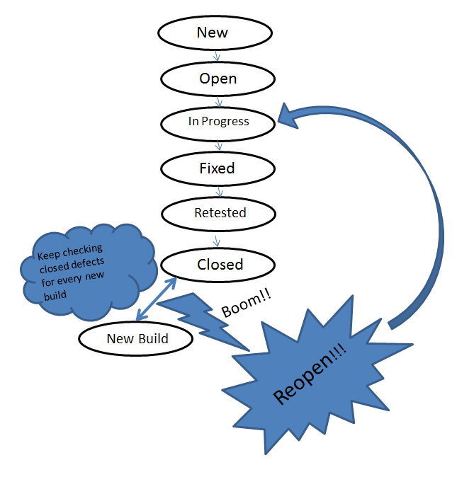
Lifecycle of a bug

Slide 9
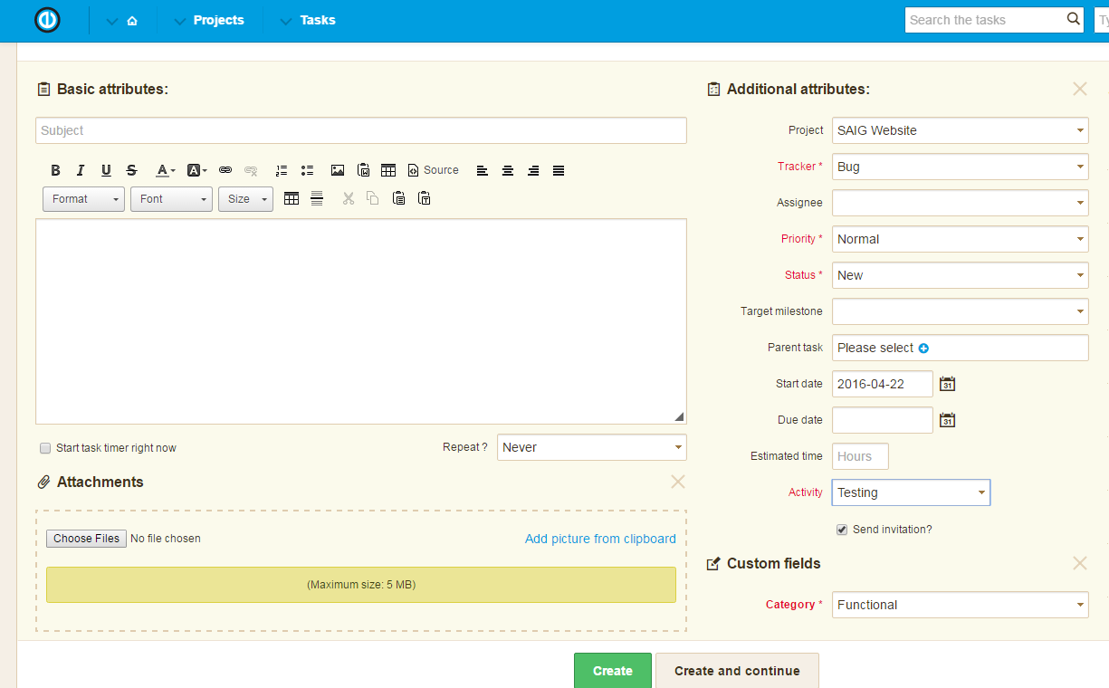
Popular Bug tracking system
Easy Redmine
Jira
Mantis
Bugzilla
TFS

Slide 10

Queries

